Slide 1
Ignacio Carreon Carrasco Student ID: A00045758 Assessment 3 Data Management and Analytics Lecturer: BAHAREH GHODOOSI

Slide 2

Dataset selected
AIRBNB listings NYC from Tableau
Why?
AIRBNB is a company that I have followed since its inception and I find it admirable what they have done over the years, from being a small startup to going public
Issues
Most listed properties on the platform
Number of reviews by location and geographic area
The number of beds available as well as their distribution
Number of properties on the platform and their distribution
Most popular areas for rent
Less interesting areas for renting real estate

Slide 3




Tool selected
Why?
by recommendation and because apparently it is the best in the market according to different sources
Problems faced
Remember how to use it
Select right data
Interpret data
Benefits
Drawbacks
Formats Wide variety of graphs
Different types of tools Compatibility
Distributon of information Examples
Intuitive platform
Vast information
We have to download a program

Slide 4
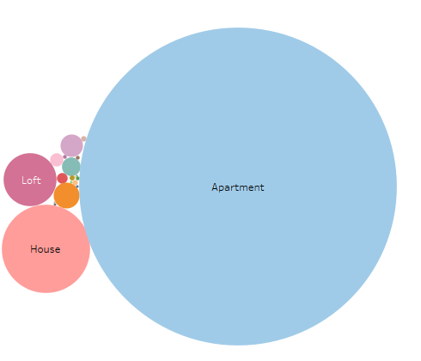
Section 3: Visualisations (Diagrams) On every PowerPoint slide, copy a diagram (visualisation) and beneath every diagram briefly explain what information/knowledge you obtained from the diagram. Make as many PowerPoint slides as you want to
Number of properties per type
The type of properties that AIRBNB has on its platform and which are the most popular to rent.

Slide 5
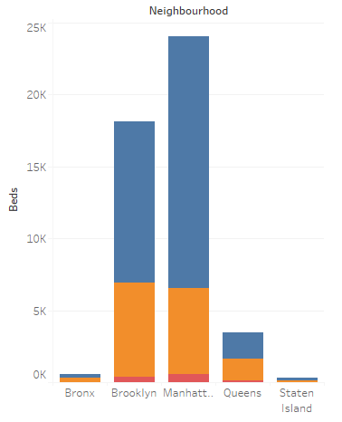
Beds by Neighbourhoods
The number of listings on the platform as well as the most popular areas within NYC, in addition to the most popular rental types.

Slide 6
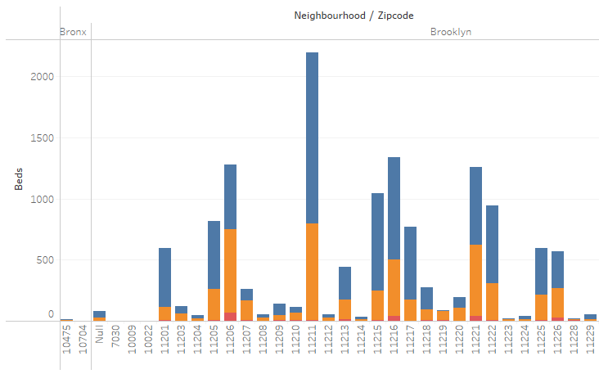
Beds by Zipcodes
Specifically, the zip codes with the most beds listed and the type of these.

Slide 7
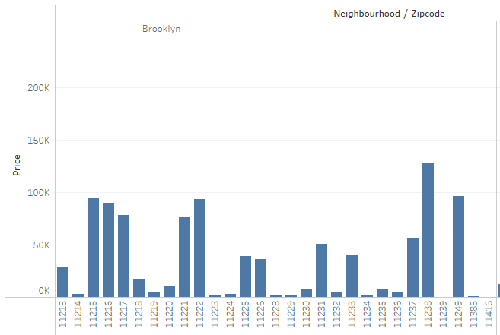
Price
The price by zip code

Slide 8
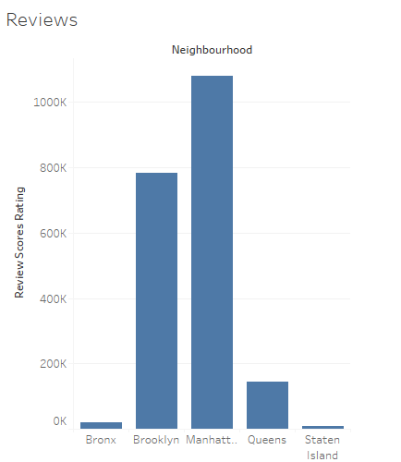
Reviews per Neighbourhood
The NyC area with the most reviews, the properties with the most reviews rent more.

Slide 9
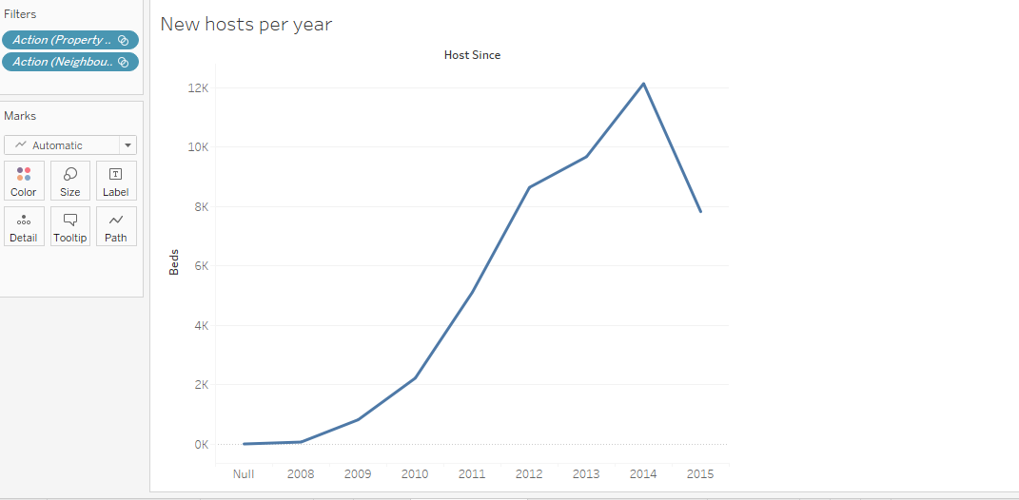
New hosts per year
The number of new hosts per year is clearly increasing since the platform was founded, the decline occurred due to state regulation.

Slide 10
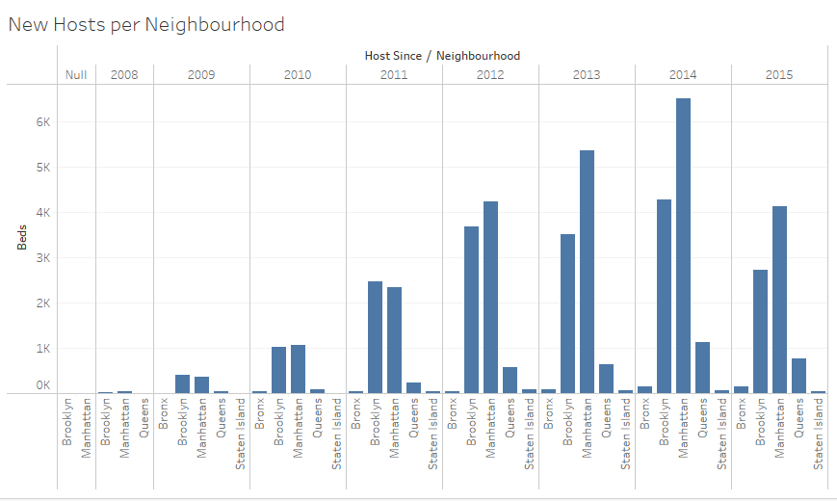
New hosts per Neighbourhood
Clearly, it can be seen that the postal codes located in Manhattan have better performance, so it is deduced that it is a tourist and investment area.

Slide 11
Findings and Limitations
AIRBNB registered a great continuous success starting in the years 2010, which was paused by regulations in the sector.
Entire apartments are the most listed properties on the platform
Houses are the second source of properties for AIRBNB
The condominiums practically do not have properties on the platform (it may be due to the way the properties are classified)

Slide 12
The price reflected in the data is confusing, I don't know if it reflects the rental price or the average price of the property in the area.
In 2014, the largest number of new hosts were registered
Staten Island is the area of New York with the fewest listings
The difference as a percentage between the zones with respect to the type of properties listed (entire apartment, room and shared room) is quite considerable

